Slide 1
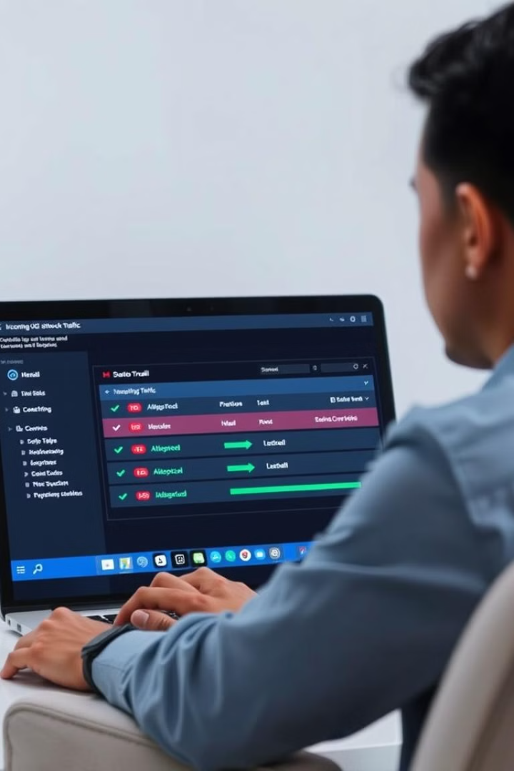
GUI Firewall Tutorial App
Bilal Khan (Leader)
Zeeshan Nasir
Abdul Basit

Slide 2

Understanding Firewalls
What is a Firewall?
Purpose of the App
A security tool that filters network traffic based on predefined rules
Provide a user-friendly tutorial for understanding and applying firewall rules

Slide 3
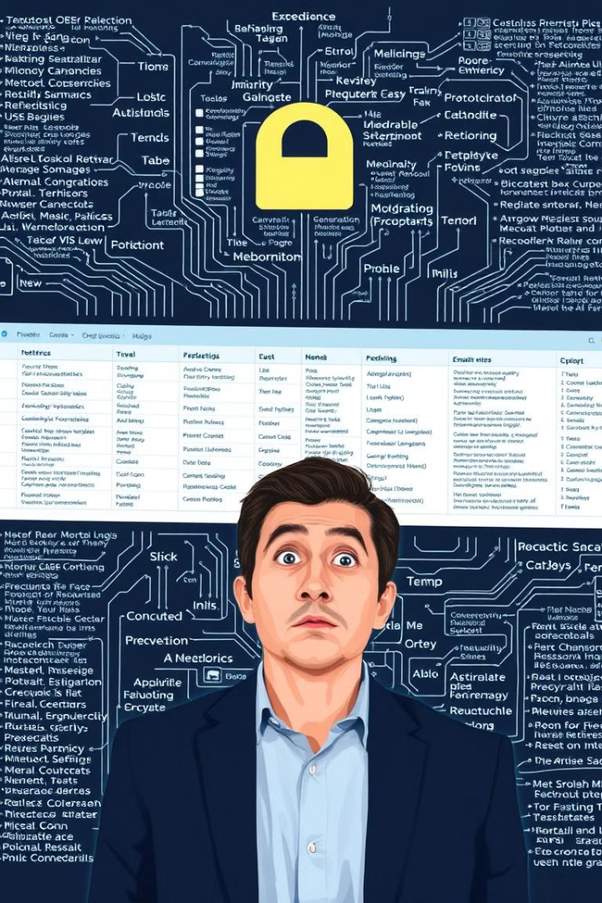
The Challenge
Intimidating Interfaces
Lack of Interactive Tutorials
Professional tools often have complex interfaces
Beginner-level tutorials are often theoretical and lack hands-on practice

Slide 4




Key Features
Rule Management
Traffic Monitoring
Add, edit, and delete firewall rules
Real-time visualization of allowed and blocked traffic
IP & Port Filtering
Event Logging
Block specific IPs or port ranges, allow trusted sources
Detailed logs of applied rules and network activity

Slide 5
App Walkthrough
1
Dashboard
2
Add Rule
3
Traffic Monitor
4
Log Viewer

Slide 6
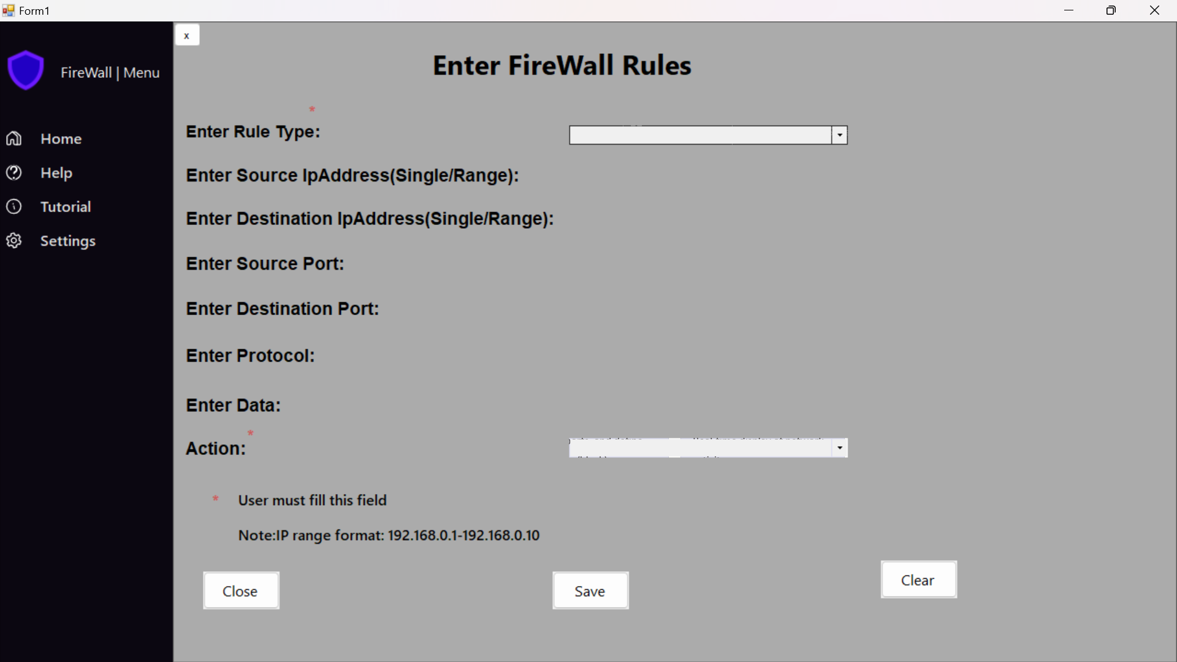
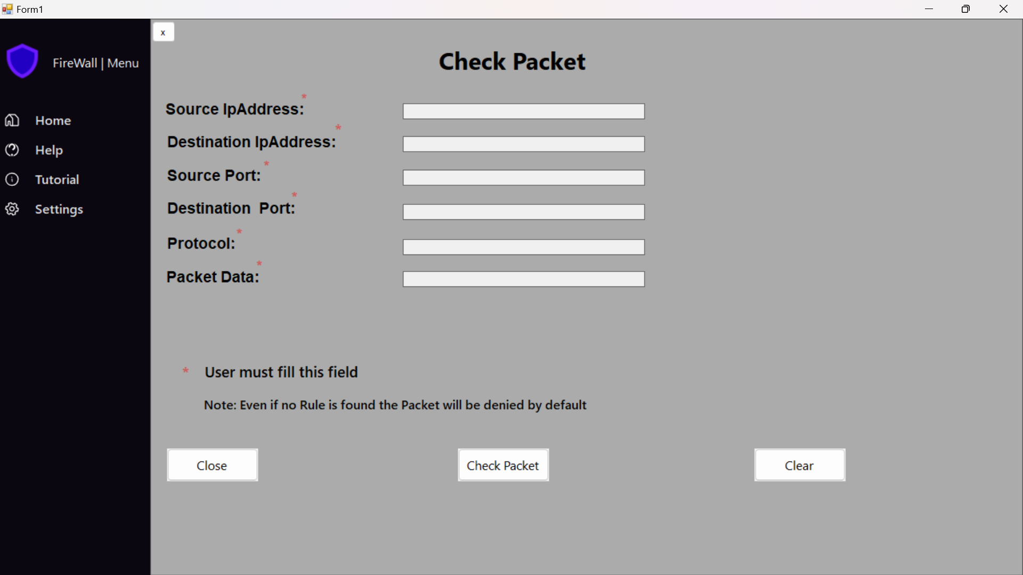
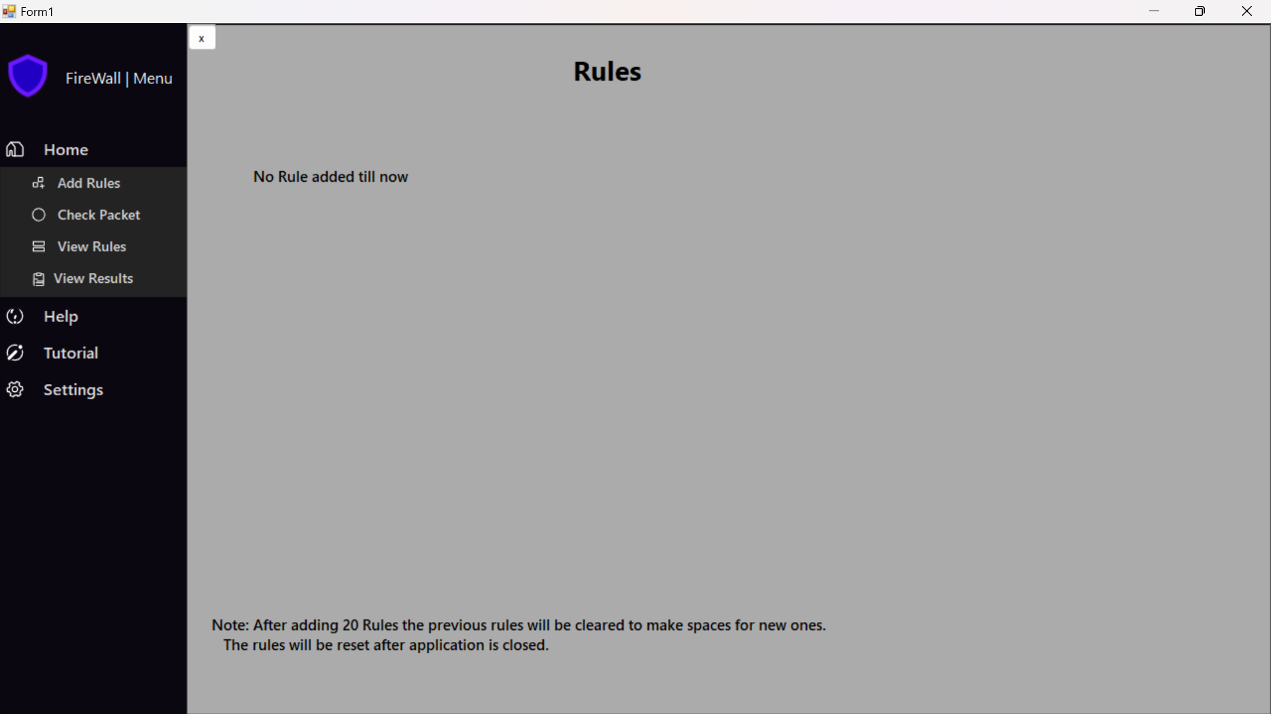
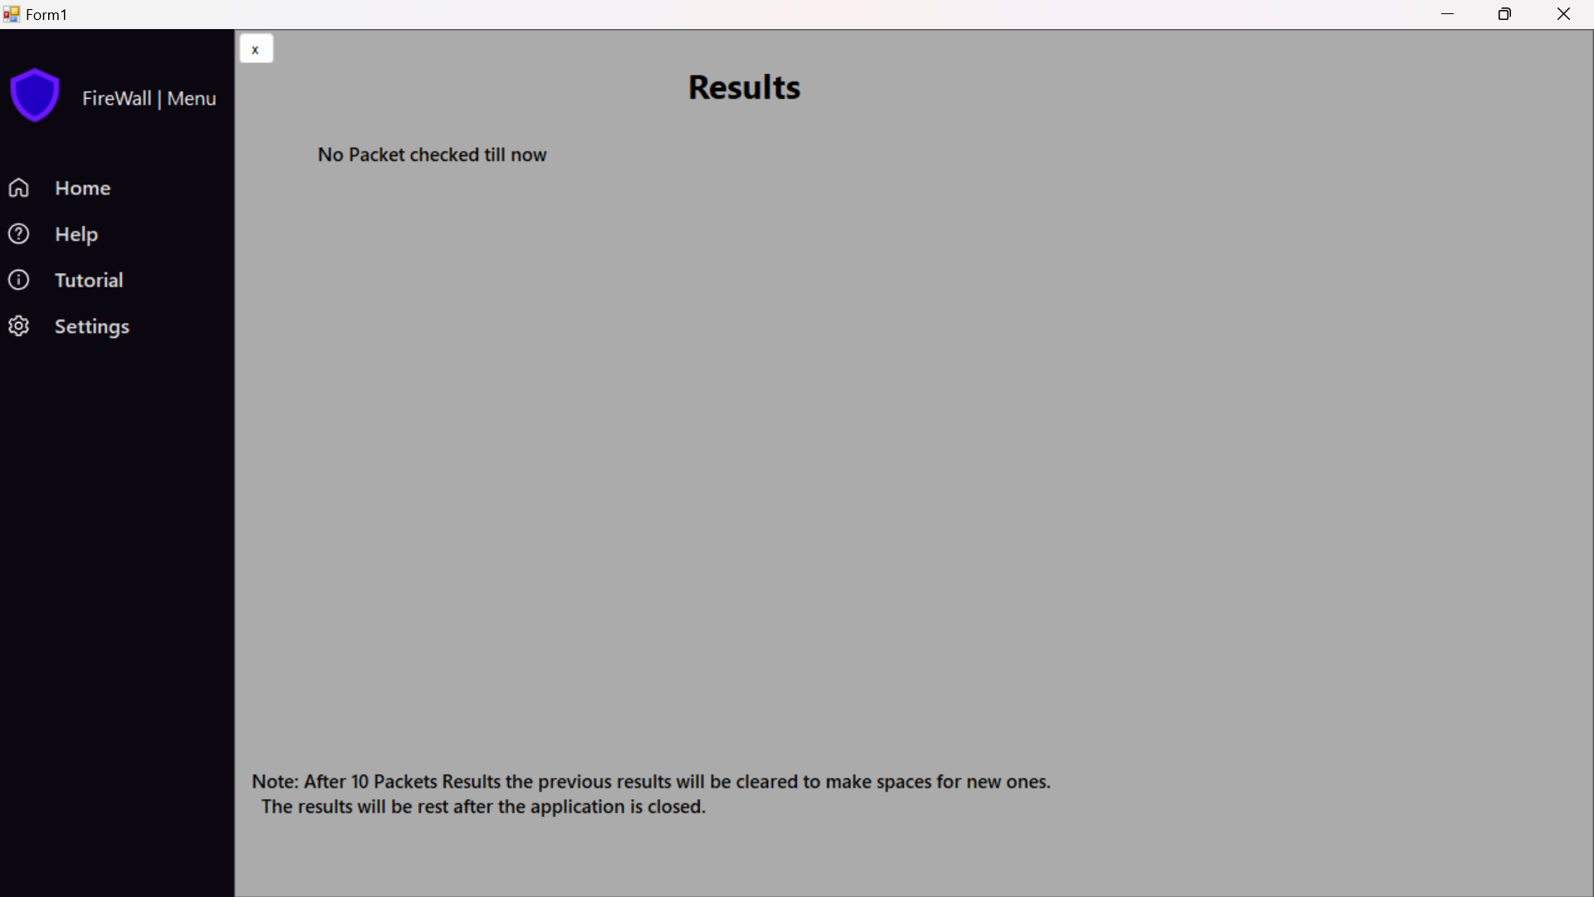
Visualizing Firewall Concepts
Dashboard
Add Rule
Traffic Monitor
Log Viewer
Central view for all functionalities
Select IPs, ports, and define action (allow/block)
Real-time display of network activity
Historical insights into network activity

Slide 7
Benefits of the App
1
Simplifies Learning
2
Hands-on Approach
3
Build Confidence
Visual representation of firewall concepts
Practical learning for beginners and students
Real-time interaction enhances understanding

Slide 8


Conclusion: A Powerful Tool
Bridging the Gap
1
Theory & practice in network security
Hands-on Learning
2
Easy-to-use interface

